Slide 1
DATA ENGINEERING WITH PYTHON!

Slide 2
What we’ll review
Addon for customizations
Minimal learning curve
Useful for daily tasks
PySpark (Apache Spark)
Pandas
Pygrametl
Scrapy
SciPy & NumPy
Data Acquisition
Data Manipulation
Data Modelling
Data Surfacing

Slide 3
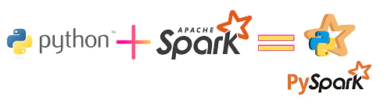
PySpark
Apache Spark is a multi-language engine for executing data engineering, data science, and machine learning on single-node machines or clusters. Spark provides an interface for programming clusters with implicit data parallelism and fault tolerance.
PySpark is an interface for Apache Spark in Python. It not only allows you to write Spark applications using Python APIs, but also provides the PySpark shell for interactively analyzing your data in a distributed environment.

Slide 4

Pandas
Pandas is a Python open-source package that offers high-performance, simple-to-use data structures and tools to analyze data. Pandas is the ideal Python for Data Engineering tool to wrangle or manipulate data. It is meant to handle, read, aggregate, and visualize data quickly and easily

Slide 5
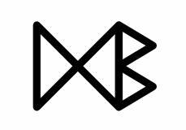
PygramETL
When using pygrametl, the developer codes the ETL process in Python code. This turns out to be very efficient, also when compared to drawing the process in a graphical user interface (GUI) like Pentaho Data Integration. It supports both CPython and Jython so existing Java code and JDBC drivers can be used in the ETL program.
http://chrthomsen.github.io/pygrametl/

Slide 6

Scrapy
Scrapy is a free and open-source web-crawling framework written in Python. Originally designed for web scraping, it can also be used to extract data using APIs or as a general-purpose web crawler. It is currently maintained by Zyte formerly Scrapinghub, a web-scraping development and services company.
Scrapy | A Fast and Powerful Scraping and Web Crawling Framework

Slide 7
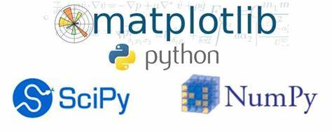
SciPy & NumPy
SciPy (pronounced “Sigh Pie”) is an open-source software for mathematics, science, and engineering. Fundamental algorithms for scientific computing in Python.
NumPy is the fundamental package for scientific computing in Python. It is a Python library that provides a multidimensional array object, various derived objects (such as masked arrays and matrices), and an assortment of routines for fast operations on arrays, including mathematical, logical, shape manipulation, sorting, selecting, I/O, discrete Fourier transforms, basic linear algebra, basic statistical operations, random simulation and much more.
Matplotlib is a plotting library for the Python programming language and its numerical mathematics extension NumPy.
SciPy
NumPy
Matplotlib

